Slide 1
HEYA AI · DEMO DECK
HeyaAI.
Voice Analytics Platform — turning AI voice agent call recordings into actionable intelligence.
SEMESTER 4 · 2026 DEMO BUILD V2.0.0
RMIT COSC2667 / COSC2777

Slide 2
HEYA AI
I. · THE PROBLEM
THE PROBLEM
AI voice agents are flying blind.
01
02
03
No Visibility
No Insight
No Action
Businesses deploy AI voice agents and get call logs but no analytics on what actually happened.
Standard platforms report whether a call "succeeded" — they don't tell you why.
Without data, managers can't coach agents, identify patterns, or prove ROI.
3 x
Voice AI deployments grew 3× in 2025 — but 80% of operators have no call quality analytics in place.
02 — THE PROBLEM
HEYA AI · 2026

Slide 3
HEYA AI
II. · THE SOLUTION
THE SOLUTION
Full call intelligence — out of the box.
WHAT WE DO
FOR WHOM
Process every call recording through an acoustic AI pipeline
Surface 7 deep analytics metrics — emotion, engagement, sentiment, silence, interruptions, speaking rate, stress
Let clients ask their data in plain English via verified RAG
HEYA VOICE AI
Multi-agent deployments — inbound and outbound flows
Any industry — property, legal, medical, hospitality
From raw .wav file to full call intelligence dashboard — automated, multi-tenant, real-time.
03 — THE SOLUTION
HEYA AI · 2026

Slide 4
HEYA AI
III. · ARCHITECTURE
HOW IT WORKS
Three layers. One platform.
INPUT
PIPELINE
STORE
SURFACE
Call Recording
Audio Pipeline
Analytics DB
Dashboard
.wav file with a transcript
pyannote · librosa · emotion2vec
PostgreSQL 14 pgvector 768d
React 19 recharts · framer-motion
A · AUDIO INTELLIGENCE
B · RAG INTERFACE
C · MULTI-TENANT SAAS
Diarisation + acoustic features + emotion
Plain-English queries over call data
Three isolation layers
pyannote separates speakers, librosa extracts pitch and energy, emotion2vec classifies vocal emotion per utterance. Runs on GPU in a dedicated conda environment.
Verified SQL stats and pgvector semantic search power answers from Cerebras Qwen3 235B — a 235-billion parameter MoE model running at 60k tokens / minute.
Every client sees only their own data. JWT claims, application-level checks, and PostgreSQL Row Level Security stack on top of each other for defence in depth.
04 — ARCHITECTURE
HEYA AI · 2026

Slide 5
HEYA AI
IV. · ANALYTICS METRICS
ACOUSTIC PIPELINE
Seven metrics, every call.
01
02
03
04
Emotion Detection
Engagement Score
Sentiment Trajectory
Silence & Interruption
Customer vocal emotion — happy, angry, sad, fearful, neutral — inferred from pitch & energy, not text.
0–100 composite of pitch variation, energy, speech rate, and pause frequency.
Is the call getting better or worse? Improving · stable · deteriorating across call thirds.
Silence ratio, interruption count, and correlation with call success rate.
05
06
07
+
Speaking Rate
Acoustic Stress
Agent Consistency
Quality Score & Grade
Words per minute and hesitation pauses — early signs of customer confusion.
Customer pitch elevation above baseline — an early warning signal for escalation risk.
Pitch standard deviation per agent — how consistent is the AI voice's vocal pattern over time?
A–F composite combining engagement, flow, outcome and emotion — one letter per call.
Emotion is detected from voice acoustics — not words. A calm script can mask genuine frustration.
05 — ANALYTICS METRICS
HEYA AI · 2026

Slide 6
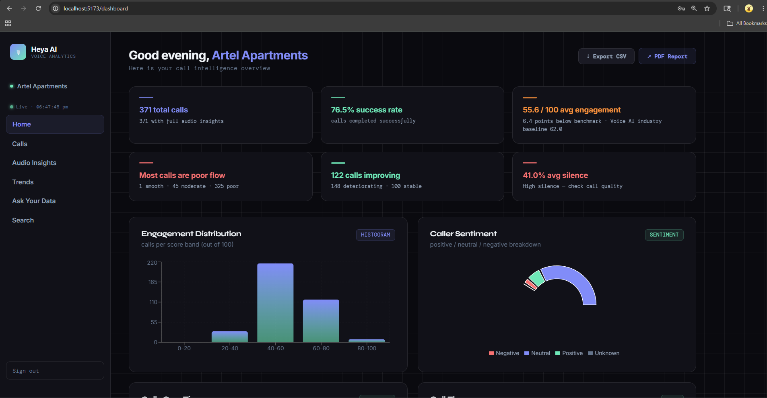
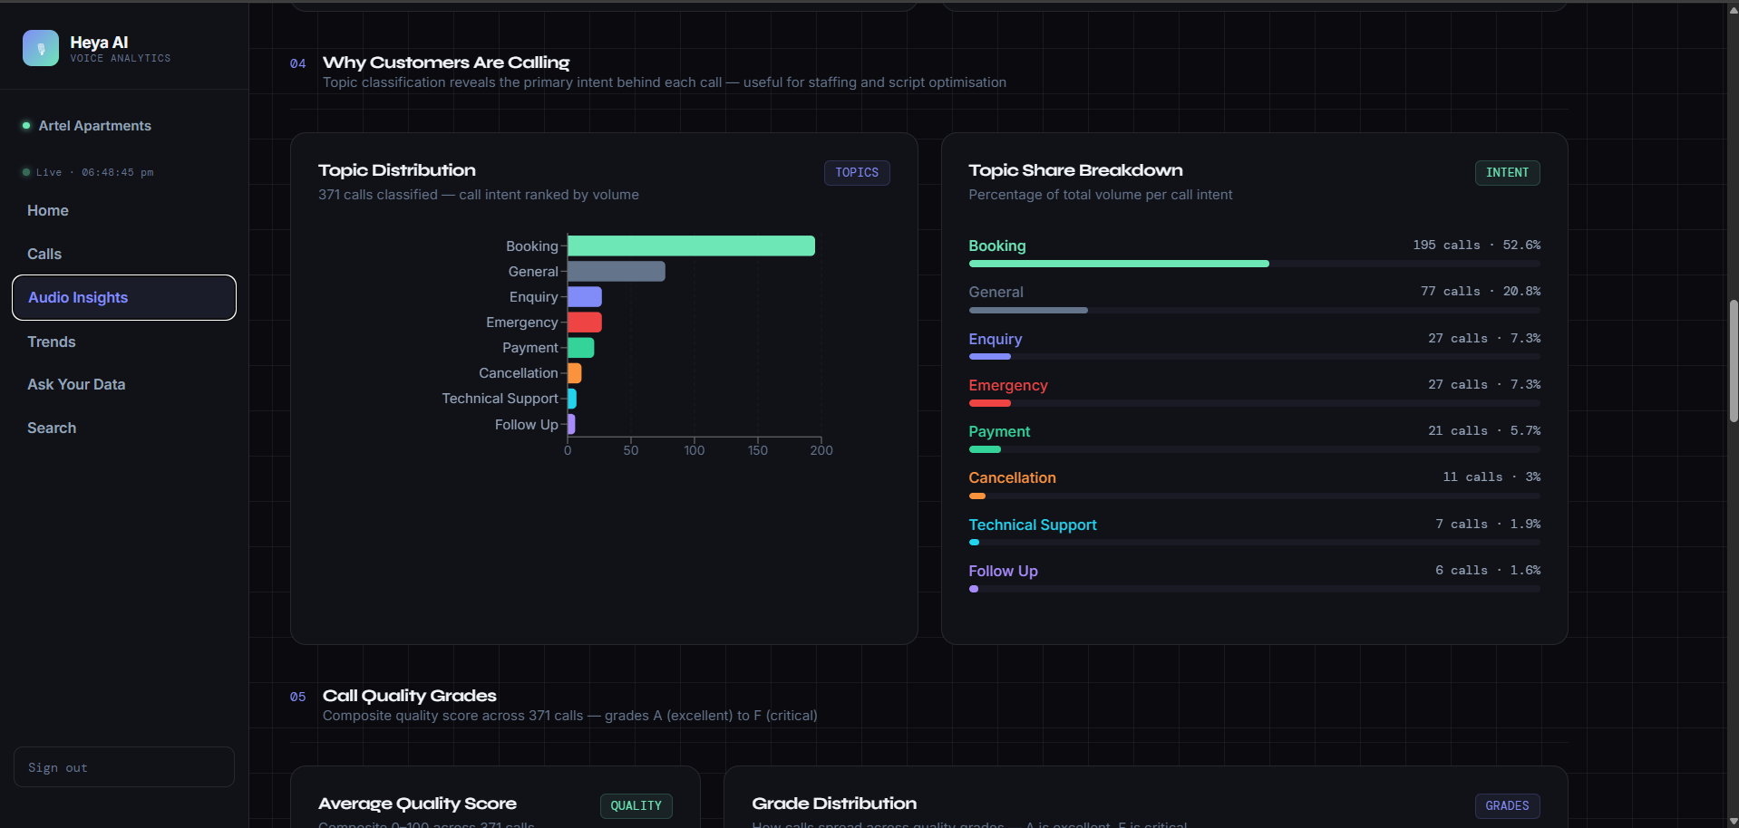
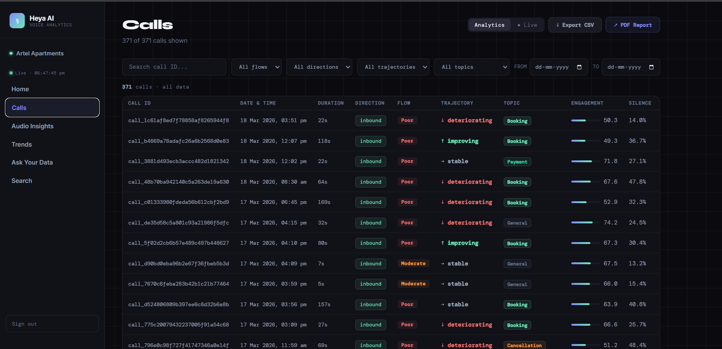
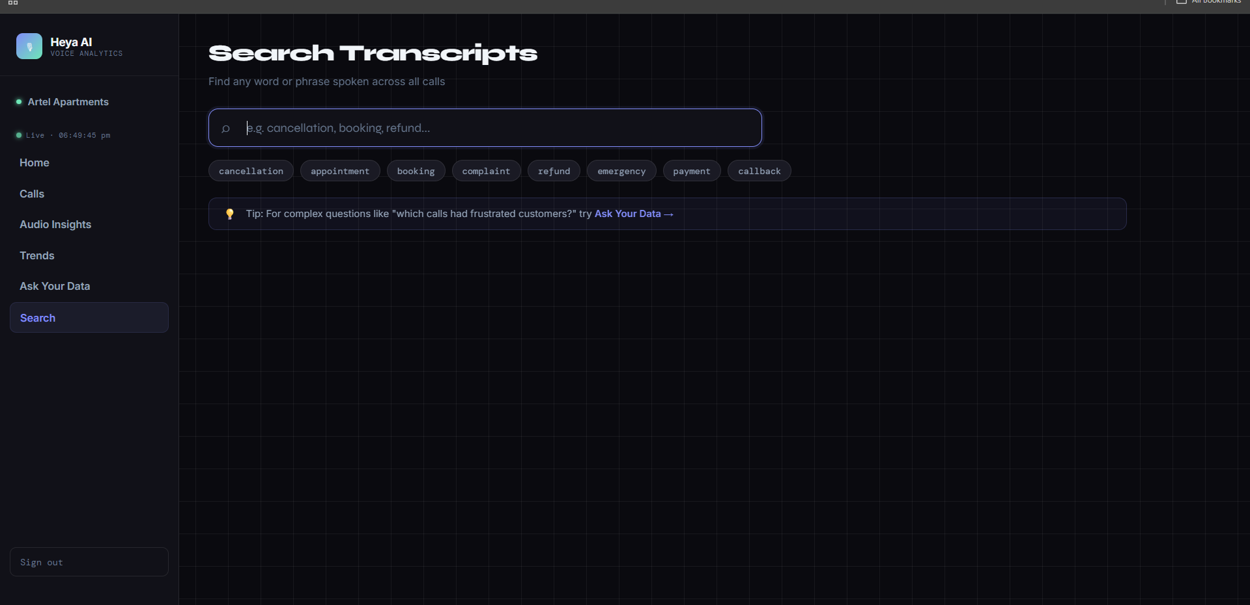
HEYA AI
V. · CLIENT DASHBOARD
CLIENT DASHBOARD
Everything a client needs, in one view.
KPI cards · 5 embedded charts · filterable call table · transcript search · RAG chat · alert inbox — all multi-tenant, all real-time.
Calls
371 calls
Audio Insights
9 sections
Search
full-text
06 — CLIENT DASHBOARD
HEYA AI · 2026

Slide 7
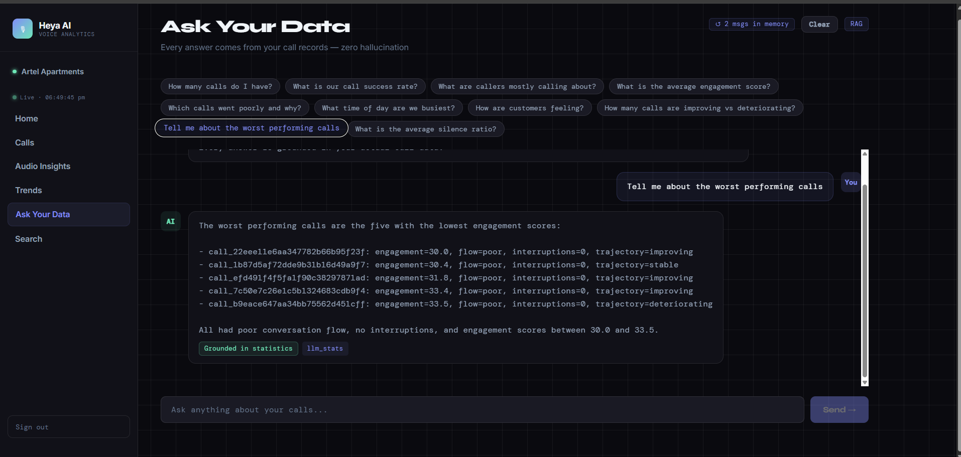
HEYA AI
VI. · ASK YOUR DATA
ASK YOUR DATA
Ask questions. Get verified answers.
Verified SQL Stats
Numbers come from the database — never invented. The LLM formats; it does not generate. Every answer carries a grounded in statistics badge.
pgvector Semantic Search
Finds relevant calls by meaning, not keywords. 768-dim nomic-embed-text via Ollama, scoped to the client.
Multi-turn Conversation
Ask follow-up questions naturally. The 2-msg memory carries context into the next retrieval.
Powered by Cerebras Qwen3 235B — 235-billion parameter MoE running at 60,000 tokens/minute.
07 — ASK YOUR DATA
HEYA AI · 2026

Slide 8
HEYA AI
VII. · ADMIN VIEW
ADMIN GOD VIEW
Full portfolio visibility for the Heya team.
i.
Client Matrix
ii.
Drill-Down Panel
All clients in one overview — KPIs, silence ratio, queue depth, engagement delta against the 62.0 benchmark.
Click any client to open seven analytics bars, a call table with emotion + trajectory, and AI-generated recommendations.
iii.
Cross-Client Feed
iv.
User Management
A single real-time call stream across every client, ordered by recency for triage and live monitoring.
Create and delete users, assign to clients, control roles. Heya admin and client roles only.
DYNAMIC INSIGHT CALLOUT
"Artel Apartments has 2.1× lower silence ratio than MVAA Legal — this correlates with 12% higher success."
08 — ADMIN VIEW
HEYA AI · 2026

Slide 9
HEYA AI
VIII. · DEMO CLIENTS
DEMO CLIENTS
Two real industry use cases.
PROPERTY · BRUNSWICK MEL
LEGAL · MOTOR VEHICLE ACCIDENT MEL
Artel Apartments
MVAA Legal
AI agent: Sasha — 24/7 inbound
3 specialised agents — inbound + outbound
Check-in codes, parking, bookings, property FAQs
Identity verification & secure SMS forms
Human escalation when patterns warrant it
Justine · front desk inquiries & routing
Sarah · outbound to at-fault drivers
Julia · Welcome Pack signature follow-up
~385
55.6 / 100
~433
3
CALLS PROCESSED
ENGAGEMENT VS BENCH
CALLS IN DATASET
SPECIALISED AGENTS
77.4%
100%
2-way
Processed
SUCCESS RATE
PIPELINE COMPLETE
IN + OUT FLOWS
PIPELINE PROGRESS
09 — DEMO CLIENTS
HEYA AI · 2026

Slide 10
HEYA AI
IX. · TECH STACK
TECHNOLOGY STACK
Built on modern, production-grade tools.
BACKEND & INFRA
AI · ML · FRONTEND
FastAPI
0.135 · uvicorn 0.42
pyannote.audio
3.x · diarisation
PostgreSQL
15 · port 5435 + pgvector
librosa + emotion2vec
acoustic + emotion
SQLAlchemy
2.x · ORM + RLS
Ollama embeddings
nomic-embed-text · 768d
python-jose JWT
HS256 · direct bcrypt
Cerebras Qwen3
235B MoE · 60k TPM
Conda envs
heya_audio + heya_pipeline
React 19 + Vite 8
recharts · framer-motion
10 — TECH STACK
HEYA AI · 2026

Slide 11
HEYA AI
X. · SECURITY
SECURITY MODEL
Enterprise-grade multi-tenant isolation.
L1.
JWT Claims
↓
client_id embedded in the signed token — cannot be forged client-side.
L2.
Application Check
↓
_require_client_access() verified at every endpoint — called manually, never bypassed.
"Cross-tenant data leakage is not just prevented — it is architecturally impossible. Even a compromised JWT cannot return another tenant's rows."
PostgreSQL Row Level Security
L3.
Voice_ai DB role — rows from other tenants are structurally invisible at the database layer.
HMAC-SHA256 webhook verification — Retell
25 RAG requests / minute / user
bcrypt password hashing — no passlib
pgvector hard-scoped to client_id
11 — SECURITY
HEYA AI · 2026

Slide 12
HEYA AI
XI. · BY THE NUMBERS
BY THE NUMBERS
The platform — at a glance.
700+
7
25+
Total calls processed
Audio analytics metrics
API endpoints
9
235B
768d
Frontend pages
LLM parameters (MoE)
Embedding dimensions
12 — BY THE NUMBERS
HEYA AI · 2026

Slide 13
HEYA AI
XII. · LIVE DEMO
LIVE DEMO FLOW
Let's see it live.
Login as Artel admin
01.
admin@artel.com / artel_2026 — show KPI cards, engagement benchmark, silence–success correlation insight.
Audio Insights tab
02.
Walk through emotion detection — acoustic vs text-based. Sentiment trajectory bars. Acoustic stress section.
Ask Your Data
03.
"Which calls had the most frustrated customers?" — then multi-turn: "What were those customers calling about?"
04.
Search
Type a keyword — "parking" or "refund" — show highlighted transcript snippets in the result list.
13 — LIVE DEMO
HEYA AI · 2026

Slide 14
HEYA AI
Turning voice data into
decisions.
FOR CLIENTS
FOR OPERATIONS
FOR THE HEYA TEAM
Know what's happening in every call — not just whether it succeeded.
Catch escalations before they become complaints. Coach on real data.
Full portfolio visibility across all clients in one place.
RMIT COSC2667 / COSC2777 · SEMESTER 4, 2026
THANK YOU

